Slide 1
Hackathon problem and data explanation
Predicting the Progression Free Survival (PFS) from patients diagnosed with non-small-cell lung cancer using multi-modal data
Gevaert’s lab

Slide 2
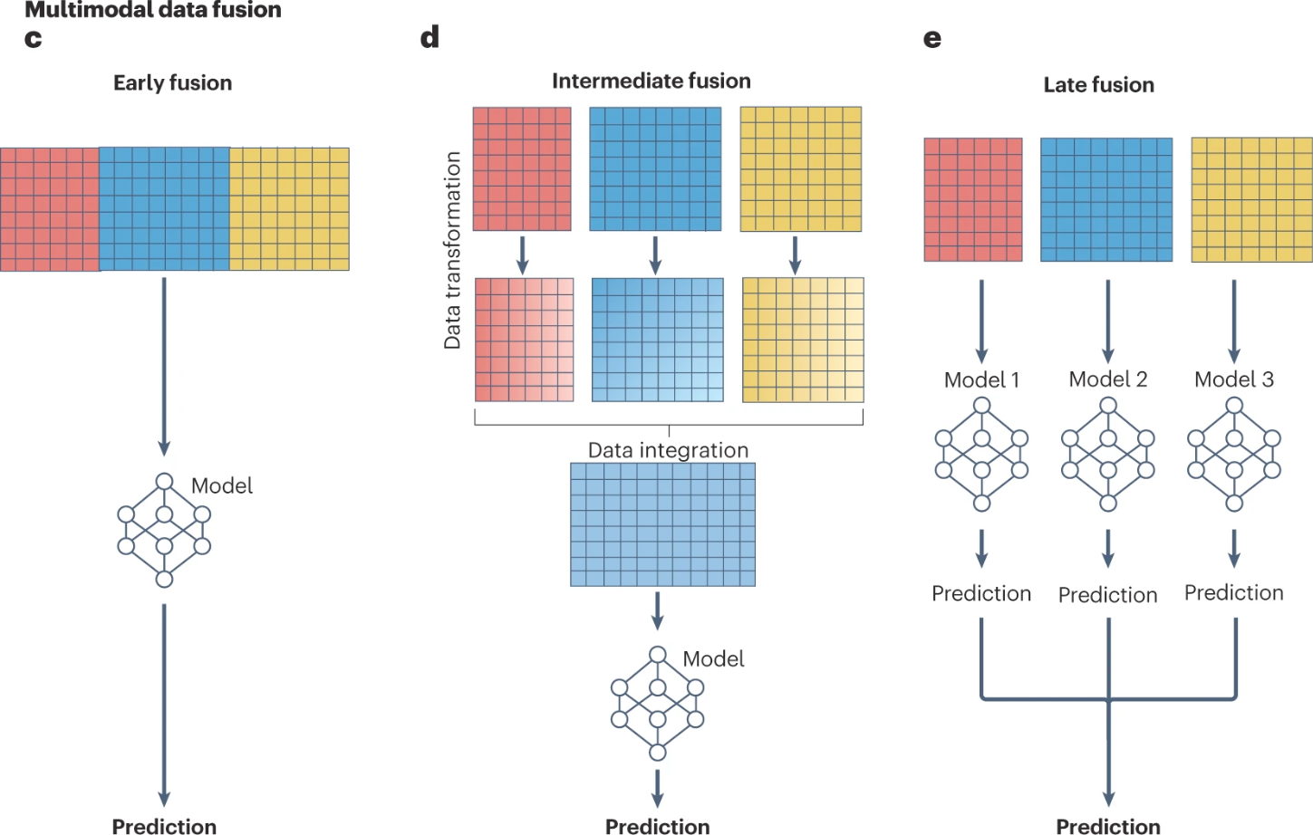
Introduction
We know that multi-modal classifiers (models that use more than one source of information) can outperform single-modality classifiers in medicine.
There exist different methods for combining the information:
Early fusion: Features are concatenated and a machine learning model is trained with them.
Intermediate fusion: Features are transformed (usually using an Artificial Neural Network), then integrated and a final model is trained (usually a linear layer).
Late fusion: Different models are trained with each data modality, and then their predictions are fused.
Steyaert et al. Nature Machine Intelligence 2023

Slide 3
Lung cancer and Progression Free Survival
Lung cancer is one of the most frequent cancer types worldwide, with an approximate number of 1.8 million deaths per year (Sung et al. 2021).
Progression-free survival (PFS) is "the length of time during and after the treatment of a disease, such as cancer, that a patient lives with the disease but it does not get worse”.
Hence, being able to accurately predict the PFS can be crucial to understand the treatment effect on a patient.

Slide 4
Dataset we are going to use
Therefore, to tackle this important issue, we are going to use the dataset provided by Vanguri et al. 2023 Nature Cancer.
This dataset contains data from 247 patients with advanced Non-Small-Cell Lung Cancer (NSLC), treated with PD-(L)1 blockade.
The dataset contains the following data modalities, which are detailed following slides:
Radiology
Digital Pathology
Genomics
Clinical data
Data is available in this Google Drive folder

Slide 5
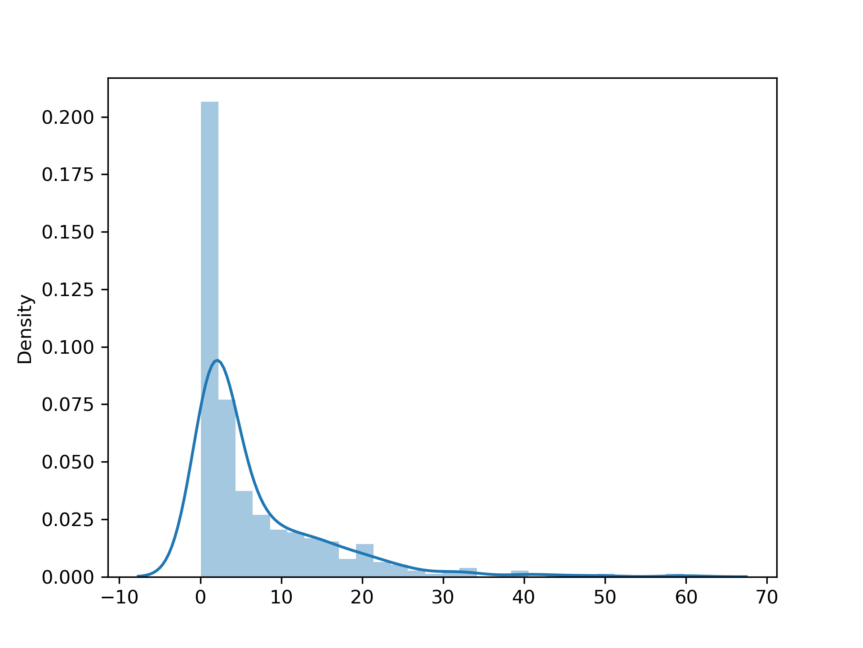
Goal
The goal of the hackathon is creating machine learning models able to predict the PFS from these patients.
These models can use a single modality, or ideally, integrate the information from multiple modalities.
Something important is that we are going to select those patients that are not censor and for which their PFS value is different from 0. Further details are given later in the slides, when the clinical data is explained.
Distribution of the PFS value in the dataset

Slide 6
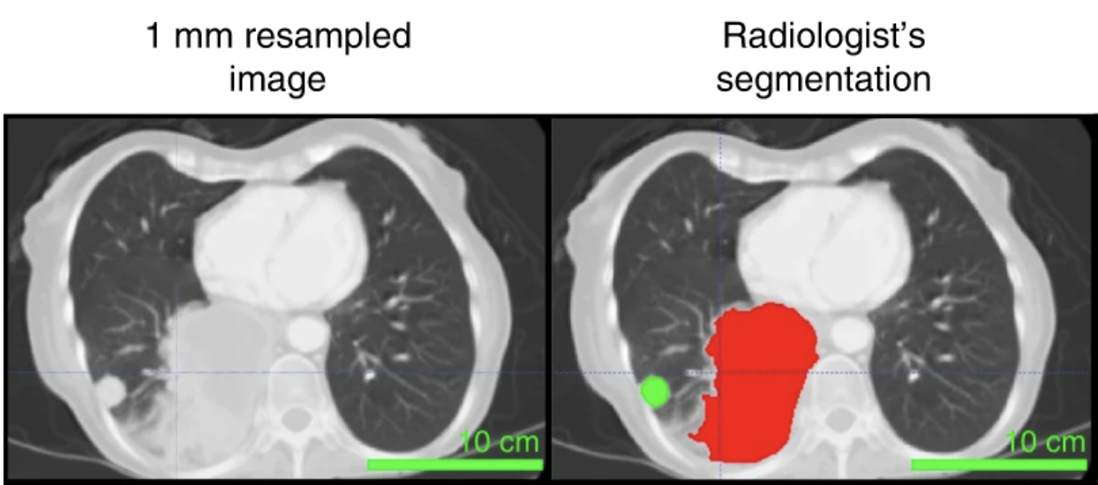
Radiology data
Path to the radiology data in Google Drive: radiology/
Within this folder we have multiple subfolders, containing the RAW and preprocessed data:
radiology_ct_raw: Raw CT scans in NIFTI format. NIFTI format is a convenient way of storing 3D dimensional data, in our case CT scans. It can be accessed using the simpleitk library, as explained in the code/read_ct_scans.py
radiology_ct_segmentations: Segmentation masks obtained using the annotations from experts. The segmentations are in MHA format. They can be accessed using the simpleitk library, as explained in the code/read_ct_segmentations.py The segmentation labels map as the following: parenchymal (1,2), pleural (3,4) and lymph nodes (5,6).
radiomics_features: Radiomics features obtained for both the training and validation sets. There are 1690 radiomics features obtained per CT scan. The features can be accessed using the pandas library, as explained in code/read_parquet.py . The patient ids needs to be accessed with the index of the dataframe.
CT slice example

Slide 7
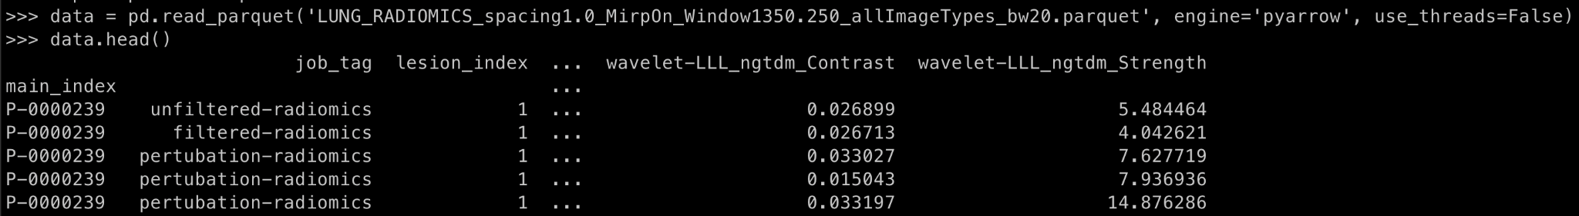
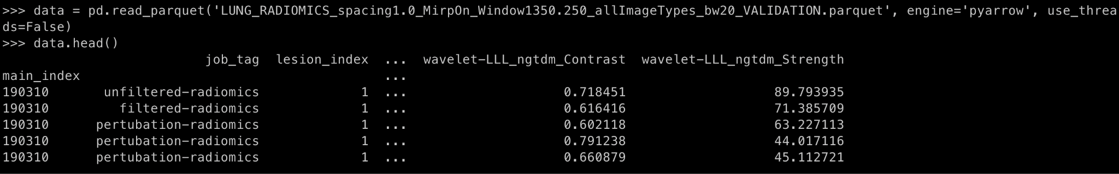
Pre-extracted features dataframes
Example on how the patient ID and features are displayed for the radiology training and validation sets

Slide 8
Radiology data
Path to the radiology data in Google Drive: radiology/
There are different approaches that can be taken:
Using the precomputed radiomics features to train a machine learning model.
Train a 2D deep learning model on the NIFTI scans, by selecting the slices from the 3D scan.
Train a 3D deep learning model that uses the tumor regions annotated by radiologists.

Slide 9
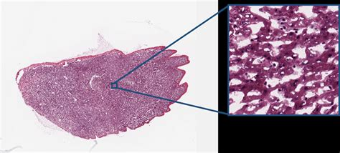
Digital Pathology data
Path to the pathology data in Google Drive: pathology/
Within this folder we have multiple subfolders, containing the RAW and preprocessed data:
pathology_slides_raw: Raw pathology slides in SVS format. The slides have huge dimensions (usually more than 10,000x10,000 pixels). Thus, the typical approach is to obtain patches from the tissue, and using those to train machine learning models. An example code to obtain patches from the SVS files is found in code/patch_gen_grid_hdf5.py
pathology_annotations: Radiology annotations performed by expert clinicians.
pathology_patches256x256_hdf5: Processed digital pathology patches. Each h5 file contains 2000 patches with a dimension of 256x256 pixels obtained from the slide. These can be later used to train deep learning models.The patches can be accessed using the h5py library, as explained in: code/read_svs_patches.py
pathology_features: Pathology texture features obtained for both the training and validation sets. There are two sets of features, one with150 texture features obtained per slide and another one with 18 texture features. The features can be accessed using the pandas library, as explained in code/read_parquet.py The patient ids needs to be accessed with the index of the dataframe.
Example of digital pathology slide and a patch

Slide 10
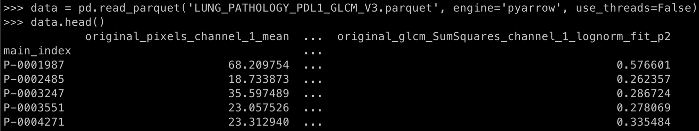
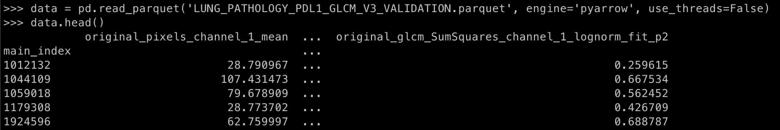
Pre-extracted features dataframes
Example on how the patient ID and features are displayed for the pathology training and validation sets

Slide 11
Digital Pathology data
Path to the pathology data in Google Drive: pathology/
There are different approaches that can be taken:
Using the precomputed texture features to train a machine learning model.
Train a tile level model to predict the PFS. In this case, patches are uses to train the model, and then the predictions are aggregated to get a slide-level prediction.
Train a slide-level patch model. Features are obtained for multiple patches in a slide, aggregated, and then forwarded to a linear layer for making the prediction
Create your own patches!
2.
3.
Training and testing phase
Training phase
Features
DL model
Prediction
Joined features
DL model
Testing phase
Linear classifier
DL model
DL model
Tile-level pred
Final prediction
DL model
Tile-level pred

Slide 12
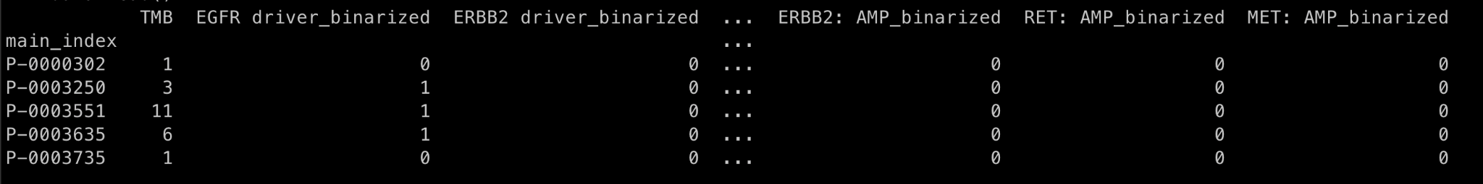
Genomic data
Path to the genomic data in Google Drive: genomic_features/genomic_data_v3.parquet
This file contains the binarized mutational status (0 no mutation; 1 mutation) for 11 different genes. The file can be read by using the pandas library as explained in code/read_parquet.py. The patient ids need to be access by using the index of the dataframe.

Slide 13
Clinical data
Path to the clinical data in Google Drive: clinical_data/clinical_data.csv
There are multiple values that are available in the clinical data information. The main column that is important for us is pfs, which has the value to be predicted.
IMPORTANT
Only those patients where the pfs_censor column is equal to 1 and which pfs values are different to 0 have to be selected.
pfs_censor = 1 & pfs != 0
There are other columns that we can recommend to be explored for their use:
smoking_status
pack_years

Slide 14
Performance metrics and splits
As the evaluation metric, we are going to use the Mean Square Error (MSE), and the Pearson Correlation Coefficient. These metrics need to be obtained in the validation set.
We have two different splits, which are detailed in the clinical/train_test_splits.csv file. The patients used in the train set have the label “train” while those in the the validation sets are divided in those patients with radiology data (rad_valid) and those with pathology data (path_valid). Importantly, when using the pre-extracted radiology and pathology features, there are two different files. One with the training set patients’ features, and a second one with the validation patients’ features

Slide 15
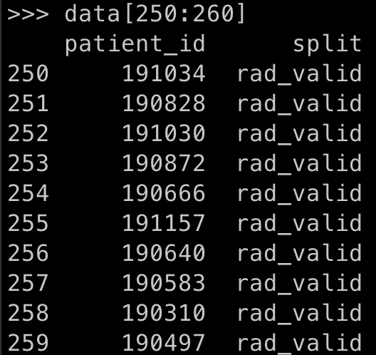
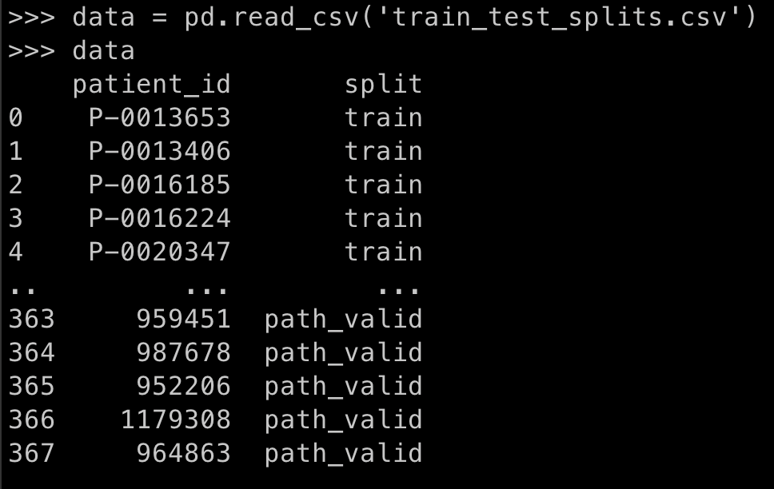
Performance metrics and splits

Slide 16
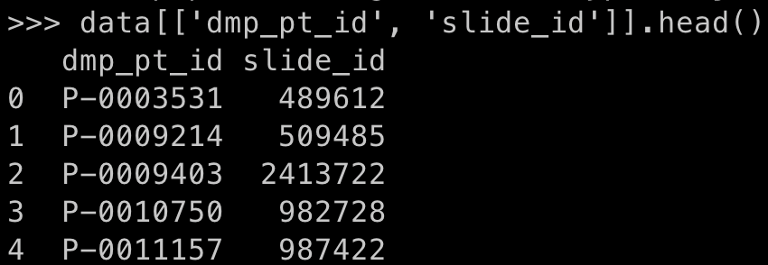
Performance metrics and splits
If the raw data is going to be used, further steps need to be done.
Pathology slides in the training set can be linked with the the slides ids using the clinical data file (clinical_data/clinical_data.csv). From the dataframe, we need to take the dmp_pt_id and the slide_id columns. This will allow us to take the slides that are in the training set.

Slide 17
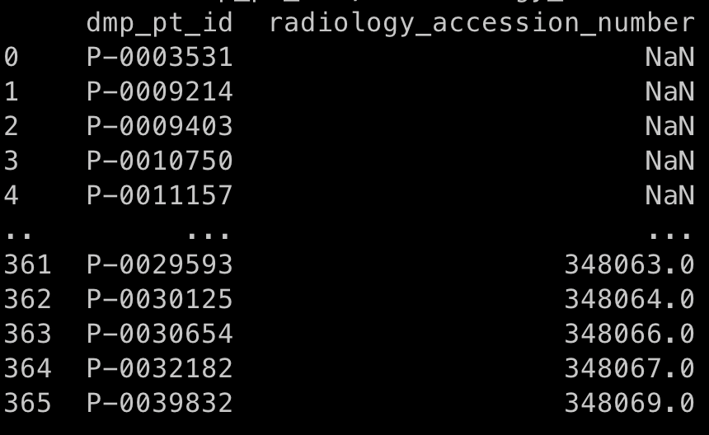
Performance metrics and splits
The same thing needs to be done for the radiology data.
Radiology CT scans in the training set can be linked with the the ct ids using the clinical data file (clinical_data/clinical_data.csv). From the dataframe, we need to take the dmp_pt_id and the radiology_accession_number columns. This will allow us to take the CTs that are in the training set.
Some patients don’t have radiology data (NaN). We have prepared a file clinical_data/lookup_patients.csv, containing the lookup table for pathology and radiology patient conversion.

Slide 18
Deliverables
Each team will have to deliver:
A presentation explaining their approach and model (approximately 10 slides)
The code they have created during the hackathon in a single ZIP file.
Each team will upload everything to the this Google Drive folder. Teams have to create a new folder inside that one with the name of the team, and then upload both their presentation and the code at the end of the Hackathon.

Slide 19
Evaluation criteria
The results will be evaluated based on multiple criteria:
The MSE and Pearson Correlation Coefficient performance in the validation set
The creativity of the solution proposed and the technical difficulty
The team contribution on the approach used
Happy coding and good luck!

